Slide 1
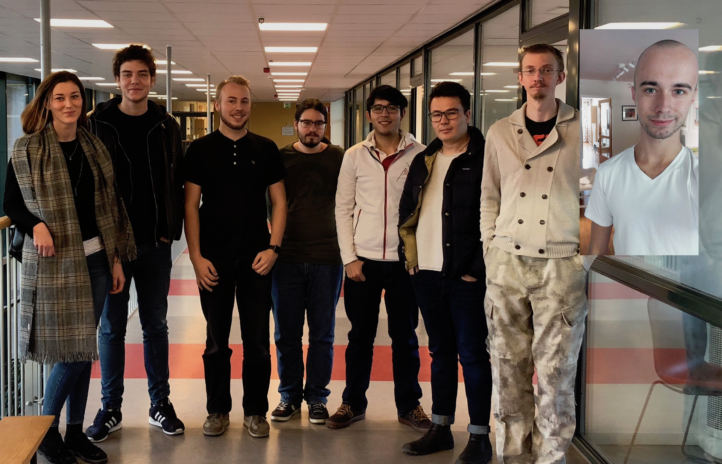
Group 1
INTERACTIVE JOINT KANBAN BOARD FOR ABB PORTS

Slide 2
Group members
André Caldegren
Anton Roslund – Project Manager
Amer Surkovic
Dzana Hanic
Jawid Nasiri
Kevin Oswaldo Cabrera Navarro
Noah Gustavsson
Robert Duras

Slide 3
Client
ABB Ports
Christoffer Holmstedt
christoffer.holmstedt@se.abb.com
021-32 46 18

Slide 4
The Project
A Kanban board for visual representation of ”artifacts” on their TeamForge server

Slide 5
So far
Meeting with client
Set up of team techonlogies
Facebook messenger group - possibly already deprecated in favor of slack
Slack for primary means of communication.
GitHub for storing our code
GitHub project for group Kanban board
GitHub wiki for documentation and planning around the project.
Google calendar for group meetings and calendar stuff.

Slide 6
The activities planned for the rest of the week

Slide 7
Any obstacles, risks or issues that have been identified
No access to TeamForge. Still unable to to get a free trial, waiting on response from Collabnet
TeamForge’s free trial is limited to 30 days

Slide 8
Questions to the steering group, if any

